Slide 1


AUBG
Used Car Price Prediction System
Aleksandar Ivaylov Ivanov

Slide 2
The problem
The used-car market is unpredictable
Prices depend on many factors (mileage, age, fuel type, market trends)
Buyers cannot estimate depreciation accurately
Sellers have difficulty pricing fairly
No widely accessible interactive tool exists

Slide 3
How does the project solve the problem
Uses real historical data to learn pricing patterns
Predicts fair market prices for any car configuration
Provides multi-year depreciation forecasts
Allows side-by-side comparison of two cars
Uses ensemble ML models for high predictive performance
Offers a fast and easy-to-use web interface

Slide 4
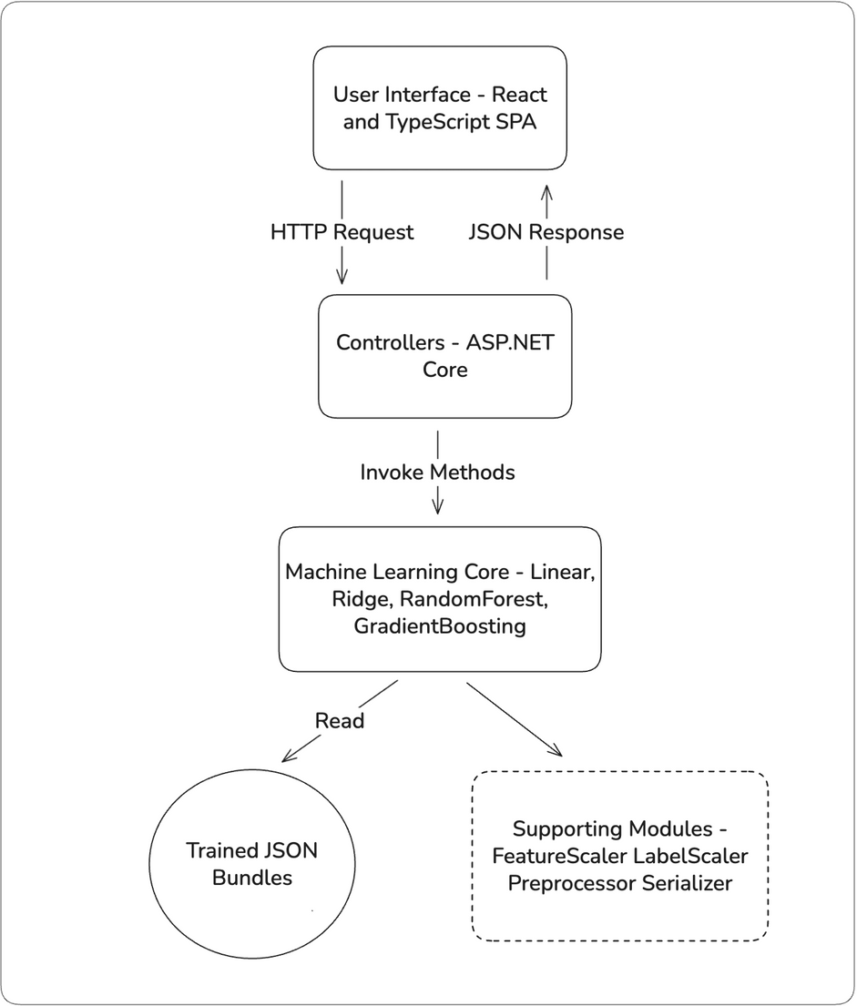
Project overview
ASP.NET Core backend
React + TypeScript frontend
CLI trainer for model building
Custom ML algorithms
Trained model bundles stored as JSON
4 types of predictions (single, comparison, range(single, comparison))

Slide 5
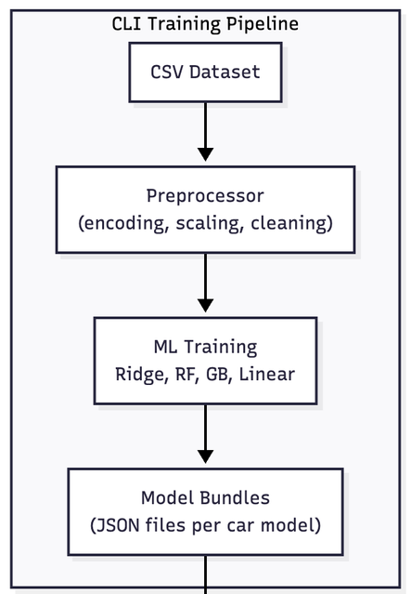
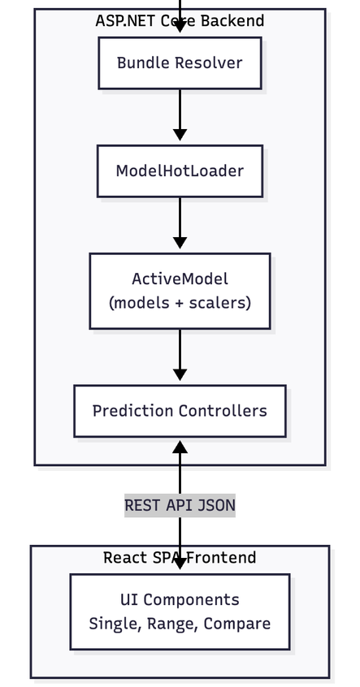
Architecture Diagram
CSV Dataset → CLI Trainer → Model Bundles
ASP.NET Core API (PredictionController, ModelHotLoader, ActiveModel)
React SPA UI (Single prediction, Range prediction, Compare)

Slide 6
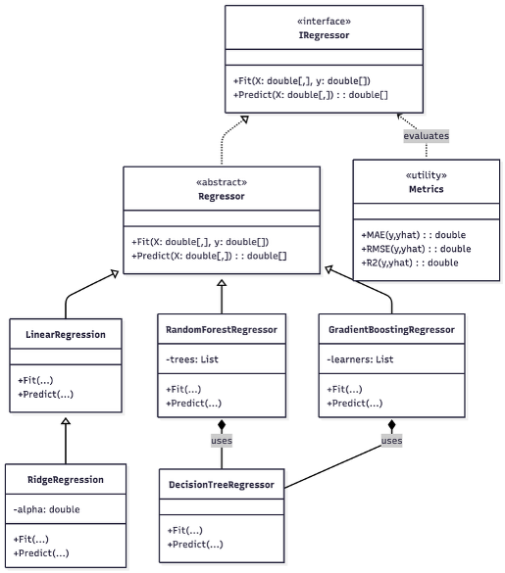
Class Hierarchy
CSV Dataset → CLI Trainer → Model Bundles
ASP.NET Core API (PredictionController, ModelHotLoader, ActiveModel)
React SPA UI (Single prediction, Range prediction, Compare)

Slide 7
Algorithms used
Linear Regression – provides the simplest baseline for price estimation
Ridge Regression – adds stability and prevents overfitting in trend modeling
Random Forest – captures nonlinear patterns that linear models miss
Gradient Boosting – delivers highest accuracy by learning from residual errors
Hybrid Models – combine Ridge + RF/GB for stronger, more reliable predictions

Slide 8
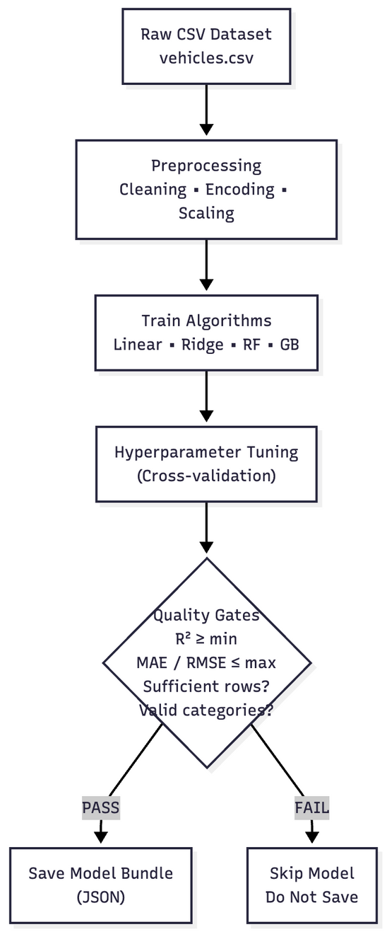
Training Pipeline & Quality Gates
Processes raw vehicle data (cleaning, encoding, feature scaling)
Trains four algorithms on each (make, model) pair
Tunes hyperparameters using cross-validation
Applies strict quality gates (R², MAE, RMSE thresholds)
Skips models with insufficient data or missing categories
Saves only high-quality models as bundles

Slide 9
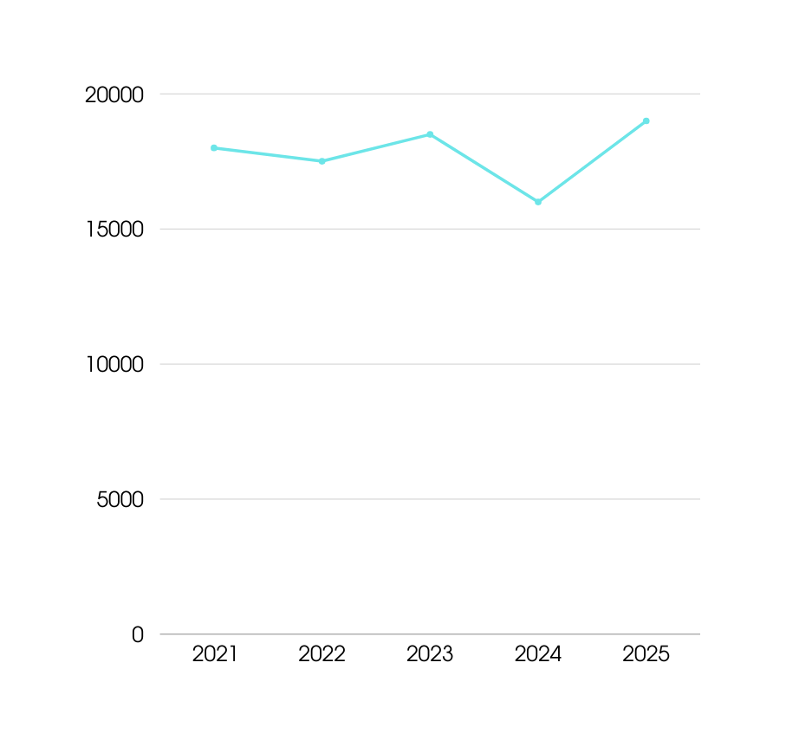
Challenges
RF/GB models were unstable for long-term forecasts → required using Ridge for range predictions
Raw data had inconsistent model names → needed a custom canonical ID system
Ensuring safe model hot-loading

Slide 10
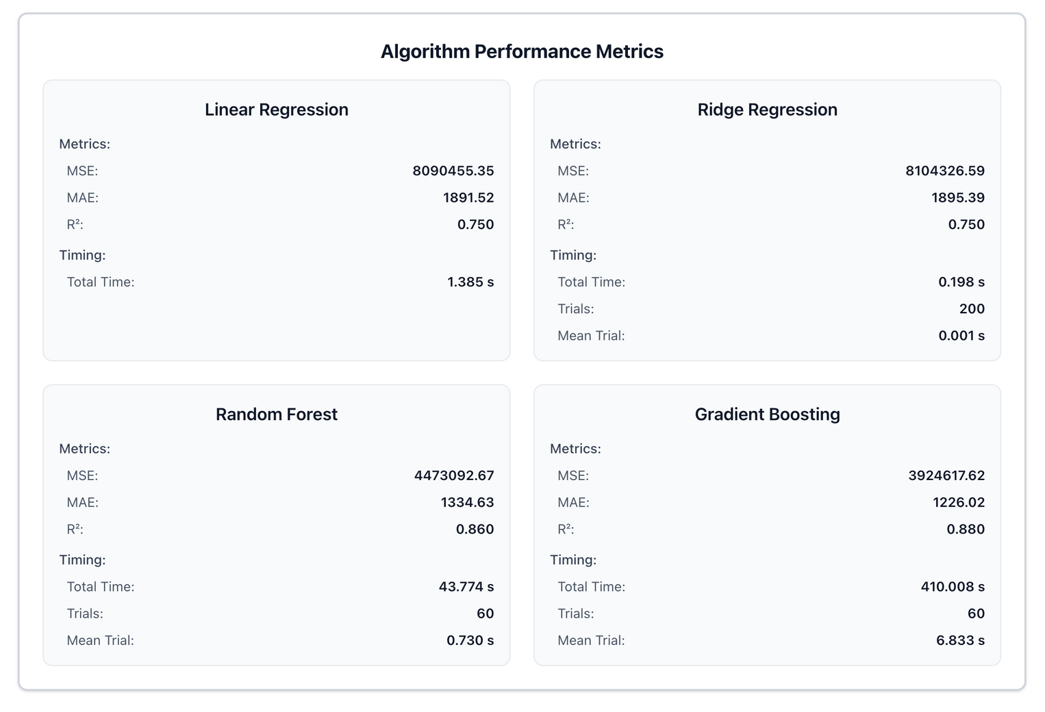
Results & Findings
High model accuracy across most car models (strong MAE/RMSE and R² scores)
RF/GB + Ridge Regression models performed best overall
Strict quality gates prevented weak models from being saved
Backend test coverage: 84%
Frontend test coverage: 98%

